Slide 1
A DATA-DRIVEN SALES ANALYSIS PROJECT
Superstore Sales Analytics Report
By- Khwahish

Slide 2
Goal:
Analyze Superstore sales data to uncover revenue trends, product performance, and category-wise insights.
Tools Used:
Python, MySQL, Power BI, Canva
2

Slide 3
Dataset Details
Dataset:
US Superstore Sales
Source:
Kaggle
Fields:
Product, Quantity, Price, Category, Region, Order Date, Sales, Profit
3

Slide 4
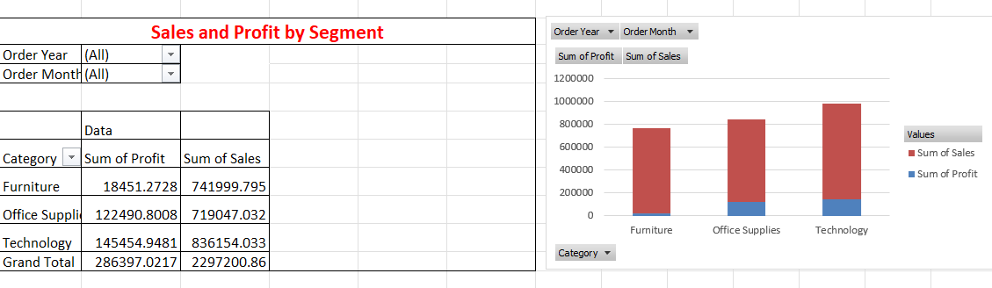
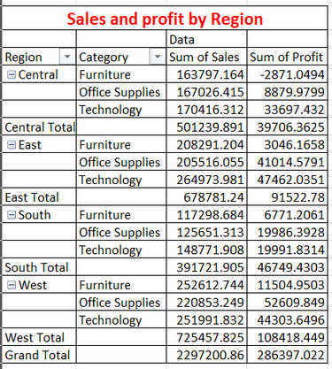
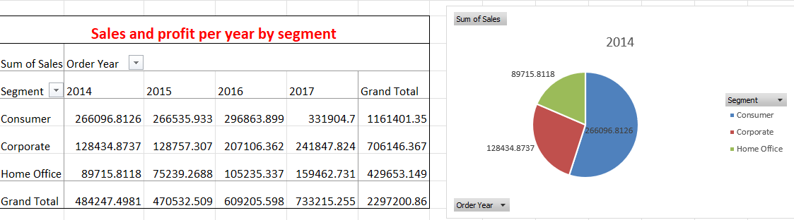
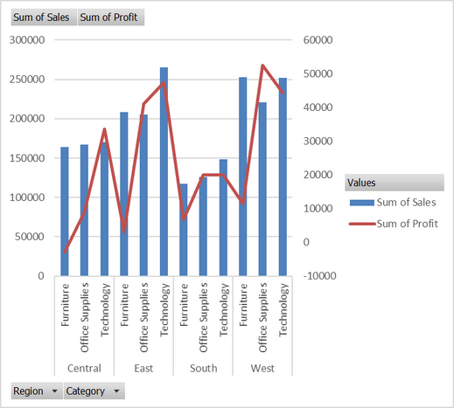
Excel-Based Analysis
4

Slide 5
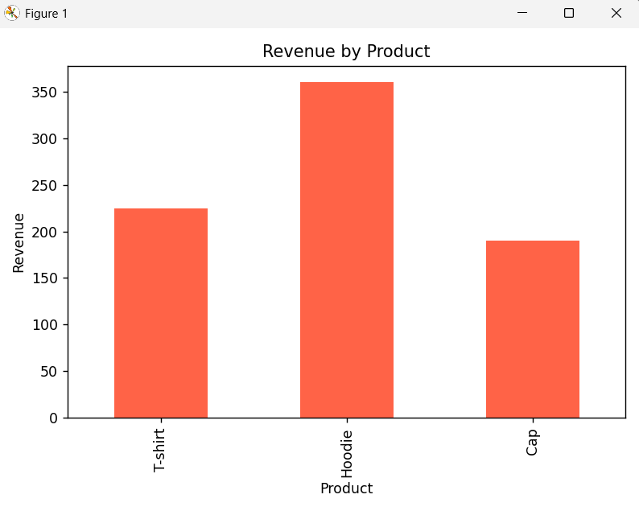
Python-Based Analysis
01
Tools: Pandas, Matplotlib, SQLAlchemy
02
Process:
Connected MySQL to Python
Retrieved and aggregated sales data
Generated revenue visualization by product
5

Slide 6
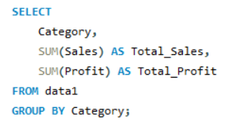

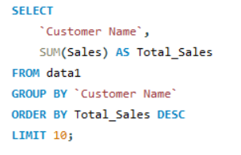
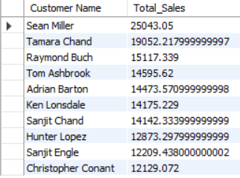
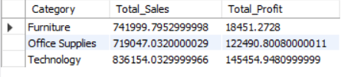
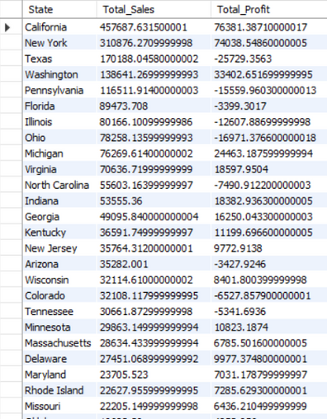
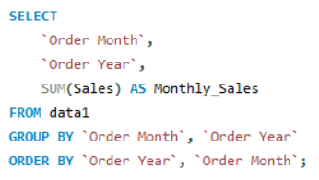
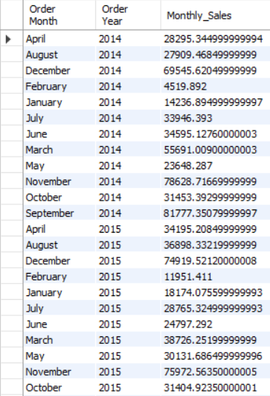
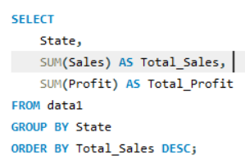
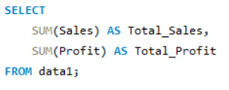

SQL-Based Analysis
6

Slide 7
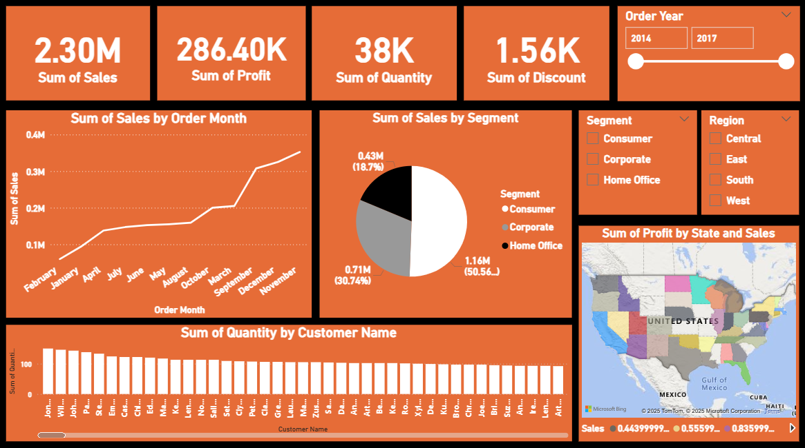
Power BI Dashboard Highlights
7

Slide 8
Key Insights
Highest selling category: Technology
Most profitable sub-category: Copiers
Lowest performing region: South
Profit margins vary drastically across product lines.
8

Slide 9
Challenges Faced
Cleaning and transforming raw data
Database connectivity
Choosing the right visualizations
9

Slide 10
Learnings & Skills Gained
SQL querying and data aggregation.
Visualization with Python & Power BI.
Dashboard design & storytelling.
Real-world data project workflow.
10

Slide 11
Future Scope
Automate report updates
Add customer-level insights
Explore predictive analytics using ML
11

Slide 12
Thank You
Contact:
Khwahish
LinkedIn- https://www.linkedin.com/in/khwahish-sahai/
12

